Slide 1
BOLIDEN HARJAVALTA COPPER AND NICKEL SMELTER - REVIEW OF SMELTER OPERATIONS, SLAGS AND SLAG VALORISATION STUDIES
Slag Valorisation Symposium Mechelen Belgium 2019
Visa Saari
R&D engineer
Harjavalta smelter

Slide 2
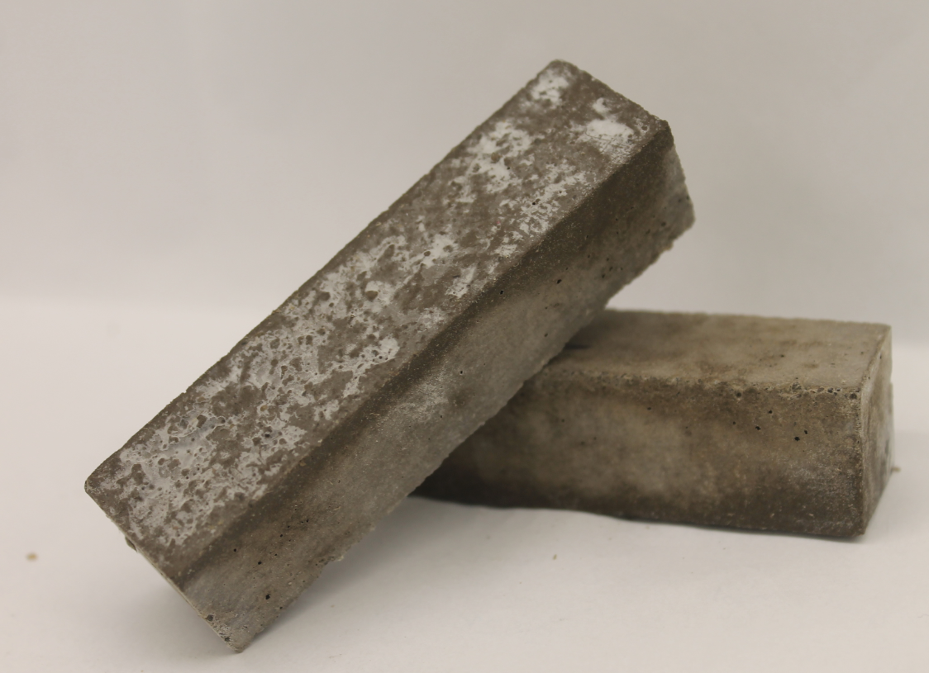
Outline
Boliden company
Boliden Harjavalta
Properties and utilisation of our Cu and Ni slags
Slag valorisation studies and results
Pilot test of Ni-slag geopolymerisation

Slide 3
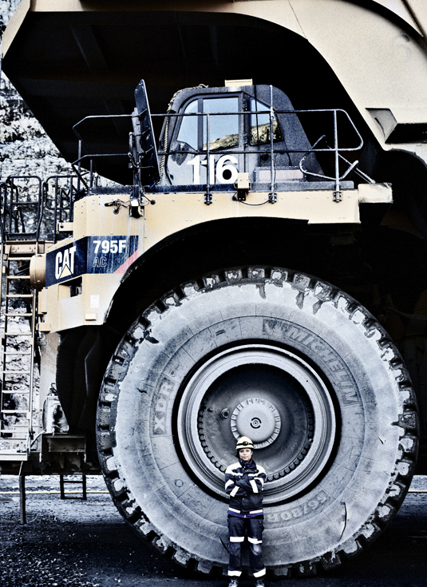
Boliden in a nutshell
A world-class mining and smelting company
Sweden, Finland, Norway, Ireland
6 mining areas, 5 smelters
Products include copper, zinc, nickel, lead, gold and silver
Number of personnel 5 700, of which in Finland 1 500
Turnover 52,5 bn SEK

Slide 4
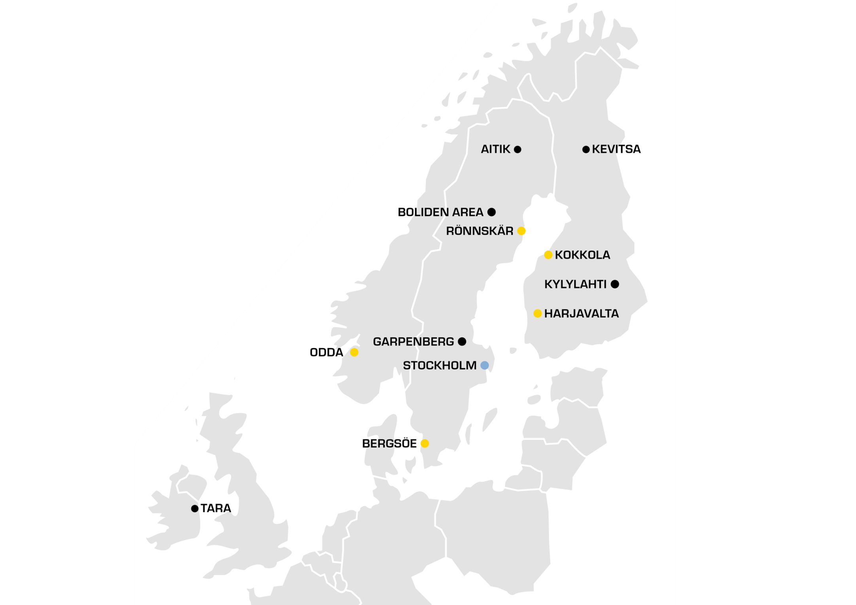
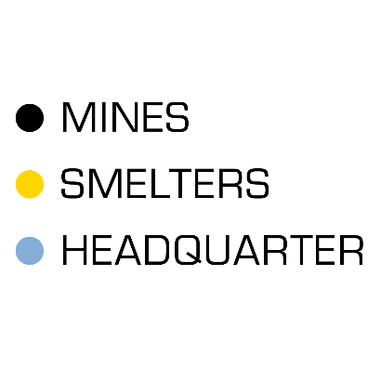
Integrated mining and smelting company
Operations in Finland:
Smelters:
Harjavalta (copper and nickel)
Kokkola (zinc)
Mines:
Kylylahti (copper, zinc, gold and silver)
Kevitsa (nickel, copper, gold and platinum group metals)
Mine
Smelter
Head Office

Slide 5
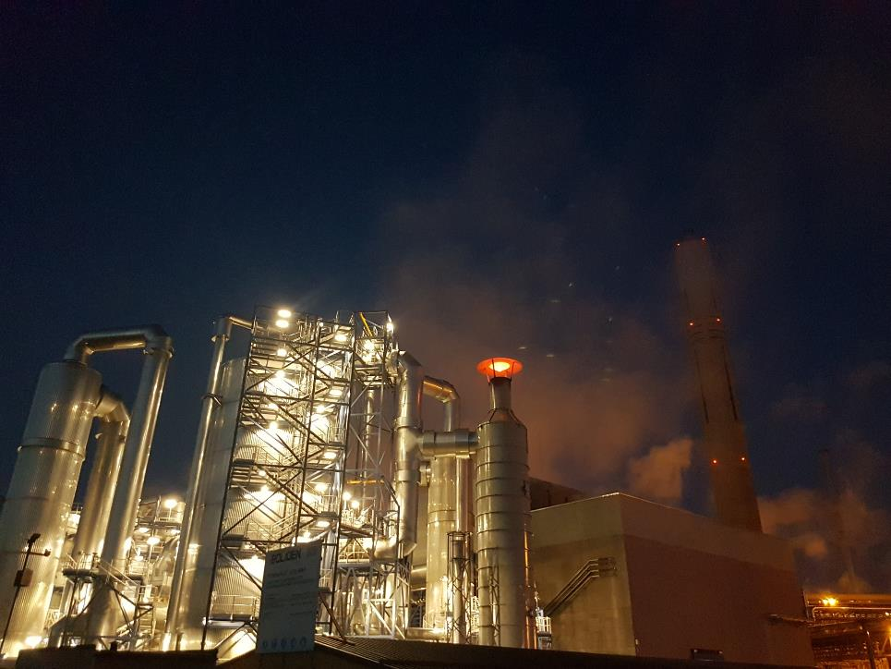
Boliden Harjavalta Efficient, responsible and international producer of copper and nickel
We produce metals for European industrial customers profitably and with high quality.
Our goal is to be the most sustainably progressive metal refiner, that takes responsibility for people and the environment.
Cu
Ni
Gold & silver
Sulphuric products
Cu & Ni sulphate
Selenium and tellurium
Platinum-palladium
540
employees
Annual production capacity
Copper cathode: 155 000 t
Nickel matte:
60 000 t
Value of production
1,4
billion euros

Slide 6
Flow sheet, copper process

Slide 7
Flow sheet, nickel process

Slide 8
Harjavalta slags
Ni-slag
220 000 t/a, utilisation rate ~30%
Reductive EF for slag cleaning
Granulated with water jets
D80 1,6 mm
Glass 64 %, fayalite 32 %, magnetite 2,5 % and small quantities of nickel sulphides and metallic nickel
Utilisation
Roofing material
Sandblasting material
Cement filler
Cu-slag
400 000 t/a
Slag concentration plant
D80 <40 um
Fayalite 58 %, glass 20 %, magnetite 17 % and small amounts of chalcosite, copper arsenides, galena and sphalerite
No utilization yet

Slide 9
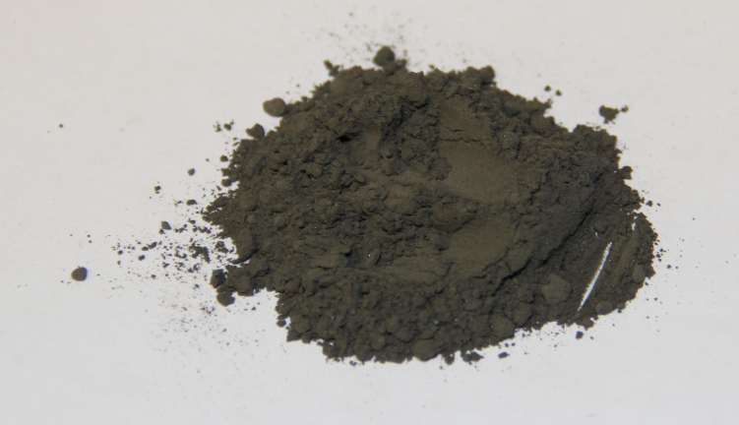
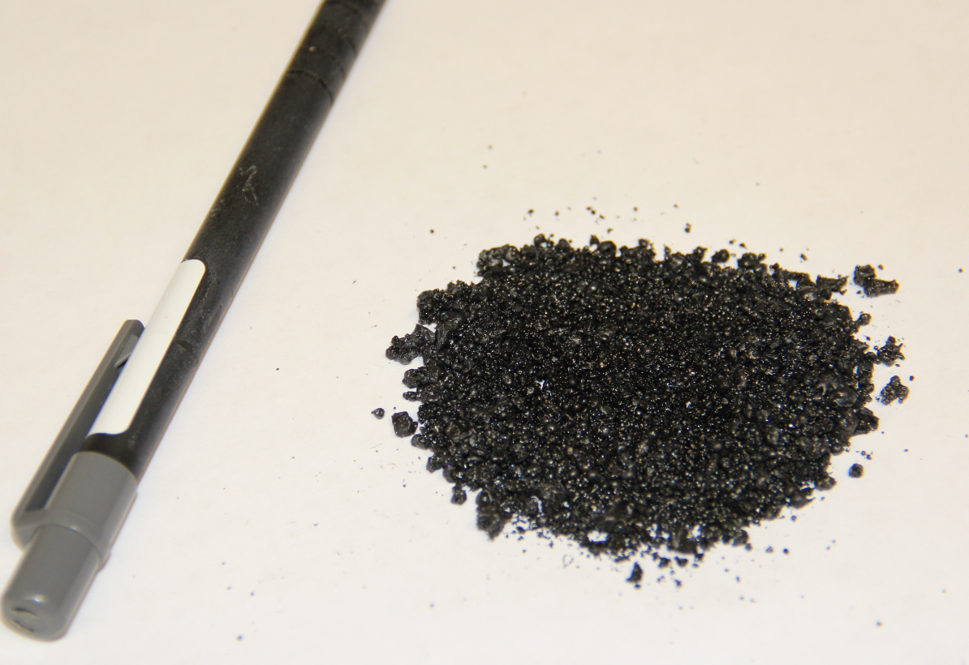
Harjavalta slags 2.
 | Fe | SiO₂ | Zn | Pb | MgO | Al₂O₃ | CaO
Copper slag | 40 | 32 | 2,5 | 0,6
Nickel slag | 40 | 35 | 0,06 | 0,005 | 6 | 2,5 | 1,9
Table: Chemical composition (wt%) of copper and nickel slag

Slide 10
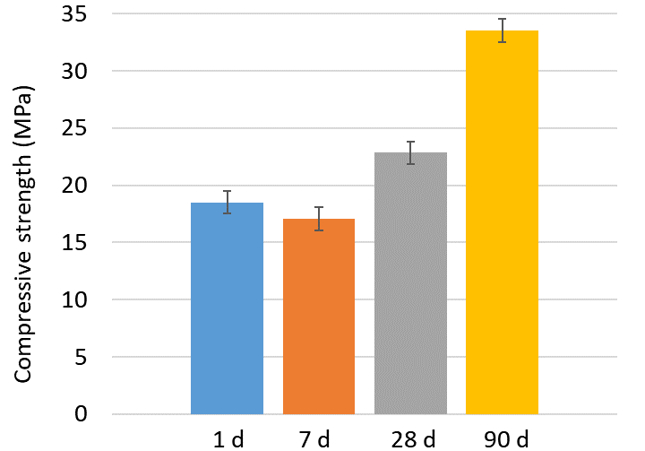
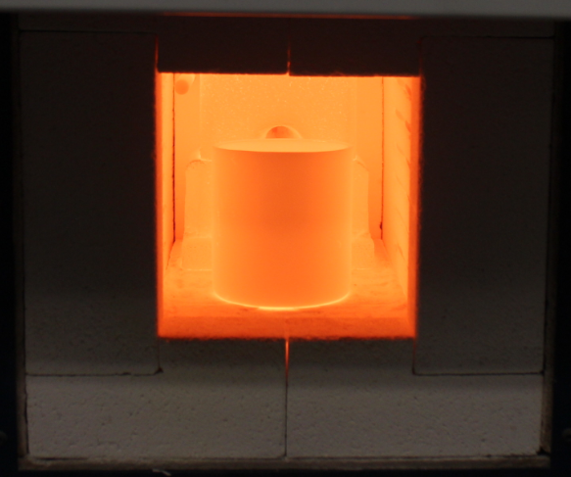
Valorisation study, Cecire
Within the Cecire-project, high-strength CSAB cements have been obtained with our nickel slag
CSAB cement: ferrite-rich calcium-sulfo aluminate belite
For CSAB cement production certain ratio’s of CaO, SiO₂, Fe₂O₃, Al₂O₃ and SO₃ are needed according to Bogue calculation and desired cement phase composition (ye’elimite, belite, ferrite)
Ni-slag can be utilized up to 17% (of cement wt%) to replace virgin raw material chemicals if cement ferrite content is 10%
Nickel slag contains other minor components which decrease the mechanical properties of the mortars when compared to reference (100% virgin chemicals)
However eco-CSAB cement can be utilized in lower strength applications like earth construction
Figure: Compressive strengths of mortar samples prepared from CSAB cement containing Ni-slag 17 wt%

Slide 11
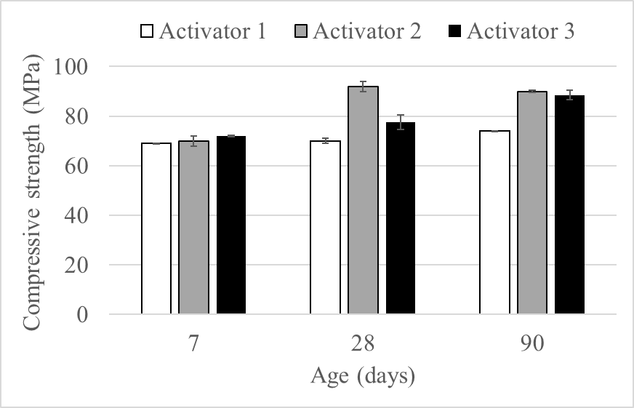
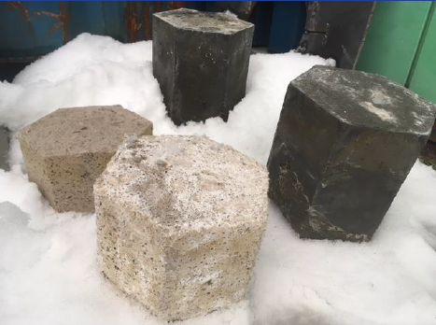
Valorisation study, Geodesign
Within the Geodesign-project, high-strength alkali-activated concretes have been obtained with nickel slag
Part of the slag was milled and the rest was original granule
Particle size optimization software (EMMA Elkem) provided good workability despite the low alkali activator (a mix of NaOH and Na-silicate) to binder ratio (0.10-0.15)
The low amount of alkali activator used decreases the environmental impact and costs caused by the alkali activator
The high specific gravity of the fayalite slag (3500-3900 kg/m3) increases the density of the alkali-activated concrete (~3000 kg/m3)
Pilot-scale tests have proven the possibility to up-scale the process, so alkali activation is seen as a potential valorisation solution for nickel slag
Figure: Compressive strength of alkali-activated nickel slag mortars using different alkali activators (a mix of NaOH and Na-silicate)

Slide 12
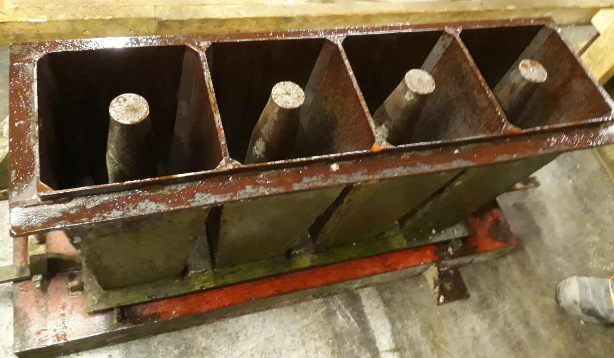
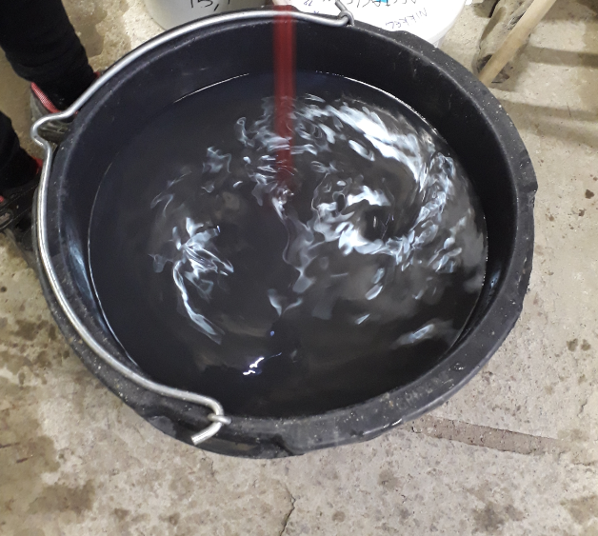
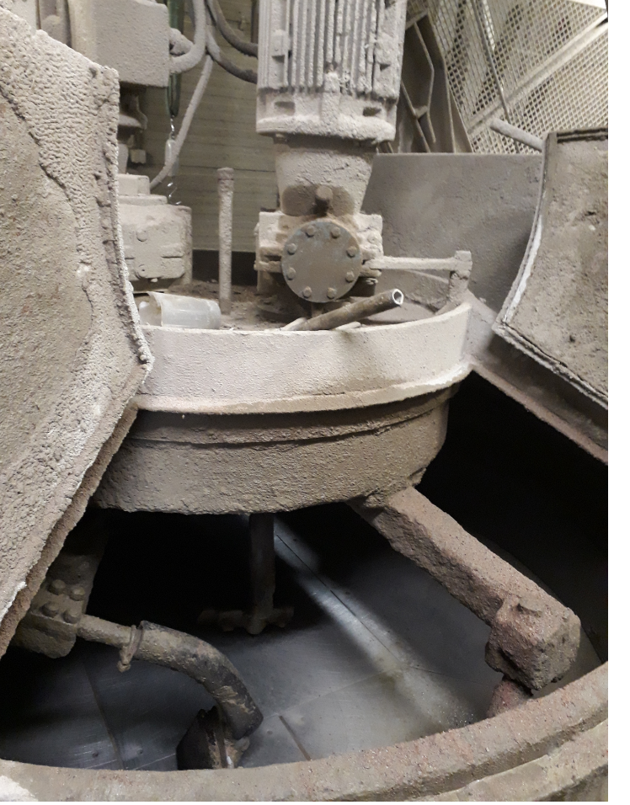
Geopolymer piloting
Ni-slag: Original and ground for 2 size fractions
Water
Alkali-activator (NaOH-based)
PVA fibers
Mould oil

Slide 13
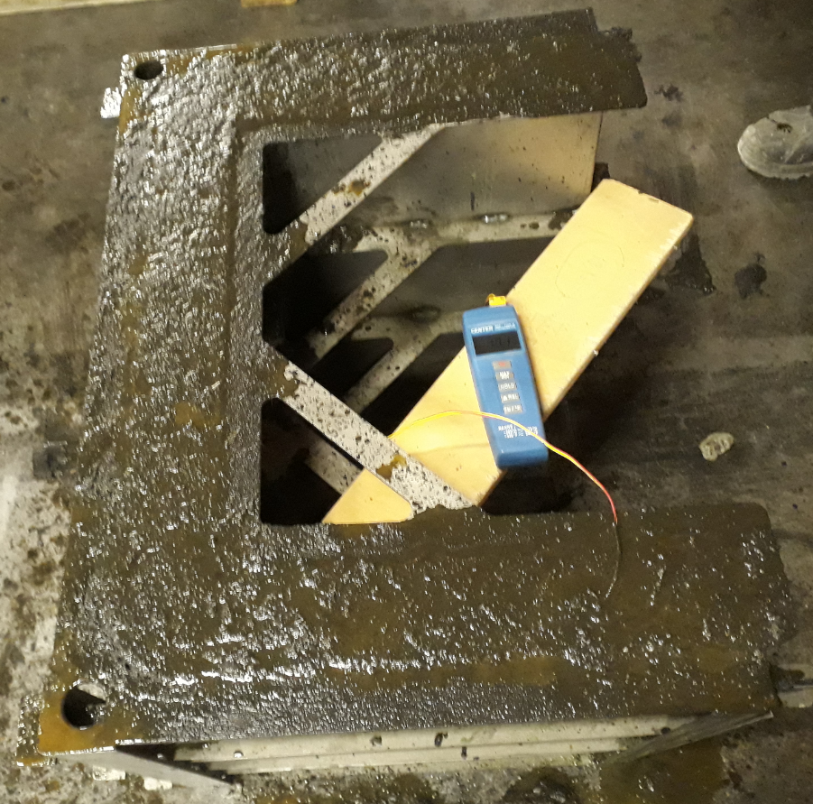
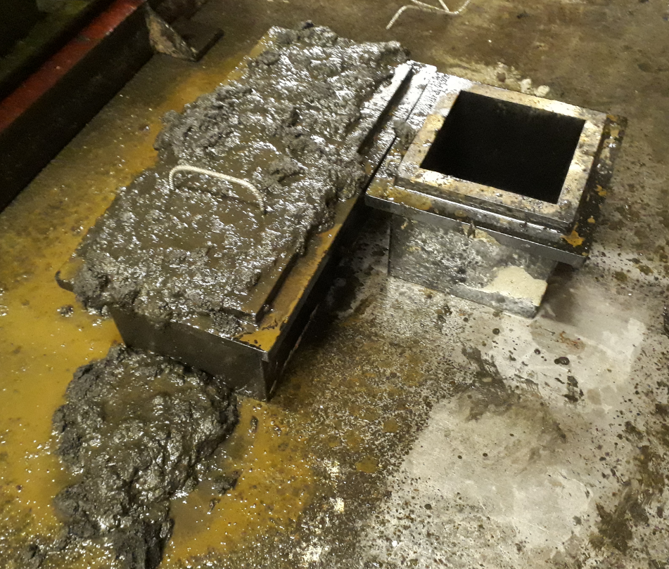
Casting the geopolymer

Slide 14
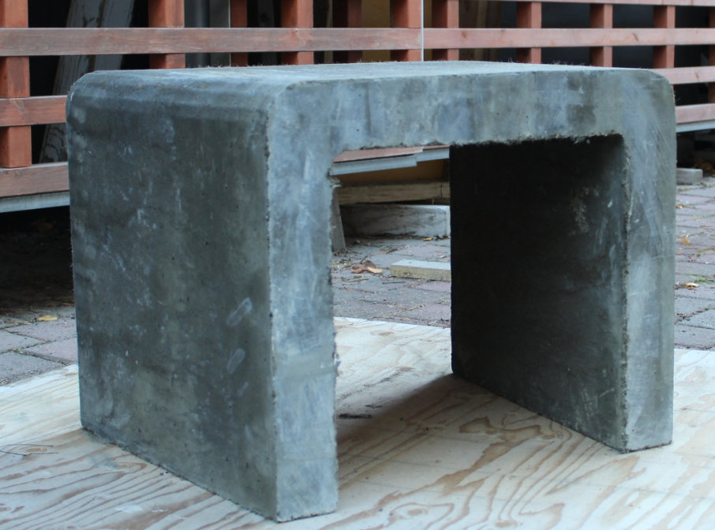
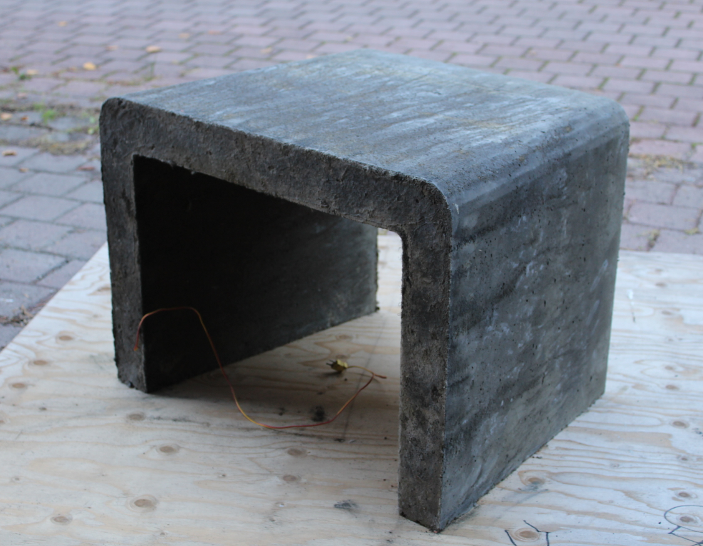
Ready bench
Photo: Christa Haataja, University of Lapland

Slide 15
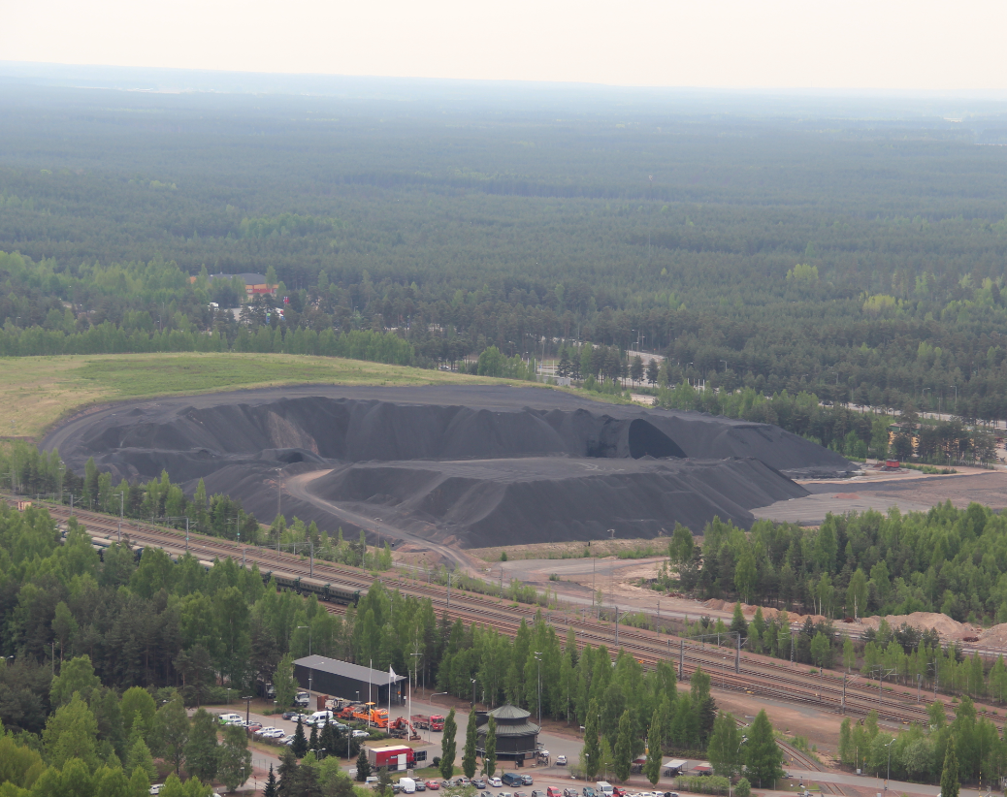
Summary
Results shown that nickel slag can be utilized as a raw material for alkali activated concrete (geopolymer) and CSAB-cement
According to the results, high compressive strength geopolymers can be made using nickel slag, optimal alkali activator and optimized particle size distribution
Despite of many projects there are not yet utilization for copper slag
Boliden Harjavalta has benefited from University collaboration related to slag valorisation
Company is open to new slag valorisation initiates and proposals from research institutes and from other companies

Slide 16
Acknowledgements
CECIRE-project
Geodesign-project

Slide 17
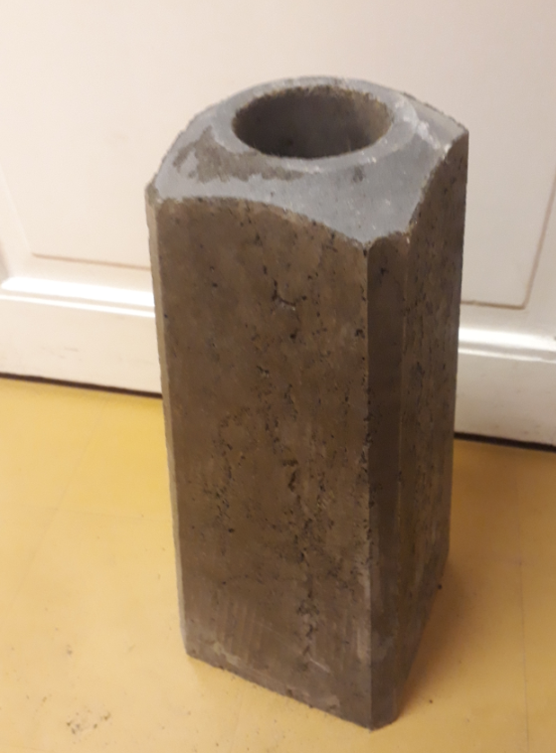
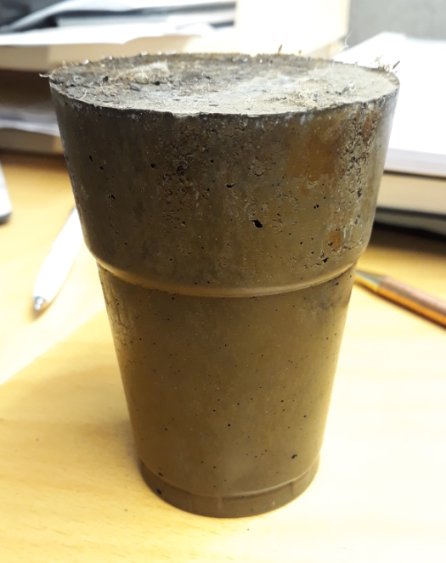
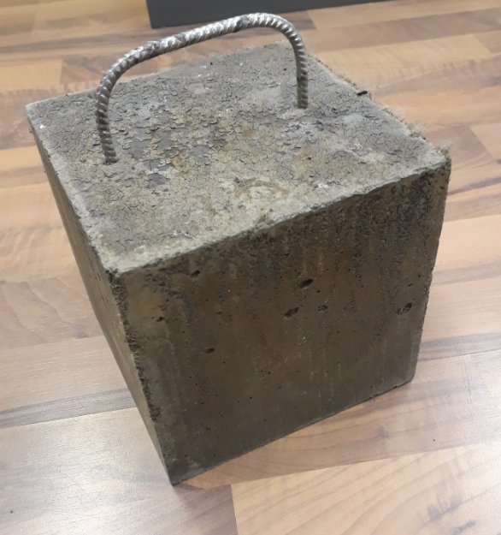
Thank you!
Visa Saari
visa.saari@boliden.com
Petri Latostenmaa
Petri.Latostenmaa@boliden.com
University of Oulu:
Juho Yliniemi
juho.yliniemi@oulu.fi
Katja Ohenoja
katja.ohenjoja@oulu.fi
Visa isteri
visa.isteri@oulu.fi

